Slide 2
CREATE DATABASE
CREATE DATABASE [IF NOT EXISTS] db_name
CREATE DATABASE products_bhmcfarland;
MySQL tries to create database named products_bhmcfarland; if it can not an error will be issued
CREATE DATABASE IF NOT EXISTS products_bhmcfarland;
MySQL checks to see if a database named products_bhmcfarland exists; if not, it creates it.

Slide 3
DROP DATABASE
DROP DATABASE [IF EXISTS] db_name
DROP DATABASE products_bhmcfarland;
MySQL tries to drop database products_bhmcfarland, gets error if it does not exist
DROP DATABASE IF EXISTS products_bhmcfarland;
MySQL checks to see if a database name products_bhmcfarland exists; if it does, it drops it

Slide 4
Select a database
USE DATABASE
USE DATABASE products_bhmcfarland;
MySQL makes products_bhmcfarland the active database. This remains in effect until the end of the session or until another USE is issued. Any SQL which is executed during this time will execute against products_bhmcfarland

Slide 5
CREATE TABLE
CREATE TABLE [db.name.]table_name
(
column1_name data_type [column attributes]
[,column2_name data_type [column attributes]
[,column3_name data_type [column attributes]
)
Common column attributes
NOT NULL
UNIQUE
DEFAULT default_value
AUTO_INCREMENT [ = x] where x is starting number
PRIMARY KEY

Slide 6
CREATE TABLE
CREATE TABLE general_ledger_accounts
(
account_number INT PRIMARY KEY,
account_description VARCHAR(50) UNIQUE
);
CREATE TABLE terms
(
terms_id INT PRIMARY KEY AUTO_INCREMENT,
terms_description VARCHAR(50) NOT NULL,
terms_due_days INT NOT NULL
);

Slide 7
CONSTRAINTS
A constraint restricts the type of data that can be stored in a column.
This enforces the integrity of the data
Column-Level Constraints
Table-Level Constraints
Unique Constraint vs Primary Key Constraint
Both require that the row has a unique value for that column
Unique allows null values
Primary Key does not

Slide 8
Two Column Primary Key
CREATE TABLE invoice_line_items
(
invoice_id INT NOT NULL,
invoice_sequence INT NOT NULL,
line_item_description VARCHAR(100) NOT NULL,
PRIMARY KEY (invoice_id, invoice_sequence)
)
OR
CONSTRAINT tables2_pk PRIMARY KEY
(invoice_id, invoice_sequence)

Slide 9
FOREIGN KEY Constraints
Define the relationships between tables
Enforces referential integrity
Storage Engines
InnoDB – FK works
MyISAM – can define to show relationships, but they are not enforced.

Slide 10
FOREIGN KEY syntax
Column Level
CREATE TABLE invoices (
invoice_id INT PRIMARY KEY,
vendor_id INT REFERENCES vendors(vendor_id),
invoice_number VARCHAR(50) NOT NULL UNIQUE)
Table Level
CREATE TABLE invoices (
invoice_id INT PRIMARY KEY,
vendor_id INT NOT NULL ,
invoice_number VARCHAR(50) NOT NULL UNIQUE
CONSTRAINT invoices_fk_vendors
FOREIGN KEY (vendor_id) REFERENCE vendors(vendor_id) )

Slide 11
FOREIGN KEYS
Provides a name for the Foreign Key Constraint
Allows you to reference a foreign key that is a composite key

Slide 12
REFERENTIAL INTEGRITY thus far
PARENT
CHILD
VENDORS
INVOICES
1
vendor_id - PK
vendor_name
invoice_id
vendor_id - FK
invoice_number
∞
Can not insert a row in the Invoice Table, unless the vendor_id already exists in the vendor table
Can not delete a row from the Vendor Table if there are rows in the Invoice Table that have that vendor_id (orphaned records)

Slide 13
ON DELETE / UPDATE clause
CONSTRAINT invoices_fk_vendors
FOREIGN KEY (vendor_id) REFERENCE vendors(vendor_id)
[ON DELETE reference_option]
[ON UPDATE reference_option]
Reference Options:
RESTRICT – rejects the delete or update option for the parent table when matching rows exist in the child table
CASCADE – delete or update the row from the parent table, and automatically delete or update the matching rows in the child table
SET NULL – delete or update the row from the parent table, and automatically set the foreign key column(s) in the child table to null

Slide 14
ALTER table
Changes the structure of a table.
add or delete columns
change the type of existing columns
change the constraints
create or destroy indexes

Slide 15
ALTER: Add or Delete Columns
ALTER TABLE vendors
ADD last_transaction_date DATE;
(column name data type attributes)
ALTER TABLE vendors
DROP COLUMN last_transaction_date;

Slide 16
ALTER: Change existing column
Change the type of length of a column
ALTER TABLE vendors
MODIFY vendor_name VARCHAR(100) NOT NULL UNIQUE
Change the type of a column
ALTER TABLE vendors
MODIFY vendor_name CHAR(100) NOT NULL UNIQUE
Change the default value
ALTER TABLE vendors
MODIFY vendor_name VARCHAR(100) NOT NULL
DEFAULT ‘New Vendor’
Some statements will fail because it would cause the column
to lose data
ALTER TABLE vendors
MODIFY vendor_name CHAR(10) NOT NULL UNIQUE

Slide 17
ALTER: Change constraints
Add Primary Key
Add Foreign Key
Drop Primary Key
Drop Foreign Key
Coded like they would have been in the original CREATE TABLE statement
Drop Foreign Key requires that you know the constraint name

Slide 18
RENAME TABLE
RENAME TABLE vendors to vendor
Used just to rename table, not modify definition or contents
Do you have any constraints that use this table name? You should drop them and add back with new name.

Slide 19
TRUNCATE TABLE
TRUNCATE TABLE vendor
TRUNCATE TABLE:
will drop and recreate table / much faster then using a delete which will delete rows one by one
can not be rolled back
fails if there are foreign key constraints from other tables that reference the table
resets any auto-increment values to their start value
does not invoke ON DELETE triggers

Slide 20
DROP TABLE
DROP TABLE [db_name.]vendor
DROP TABLE:
deletes all the data and the table definition
deletes all constraints for the table
will not delete table is other tables have dependencies
will delete all indexes and triggers that have been defined for that table

Slide 21
INDEXES
A database feature used for locating data quickly within a table.
Speeds up joins and searches
The single most critical tool for improving database performance.
Used to limit the number of results you are trying to find.
Increase the speed in which SQL queries can be answered

Slide 22
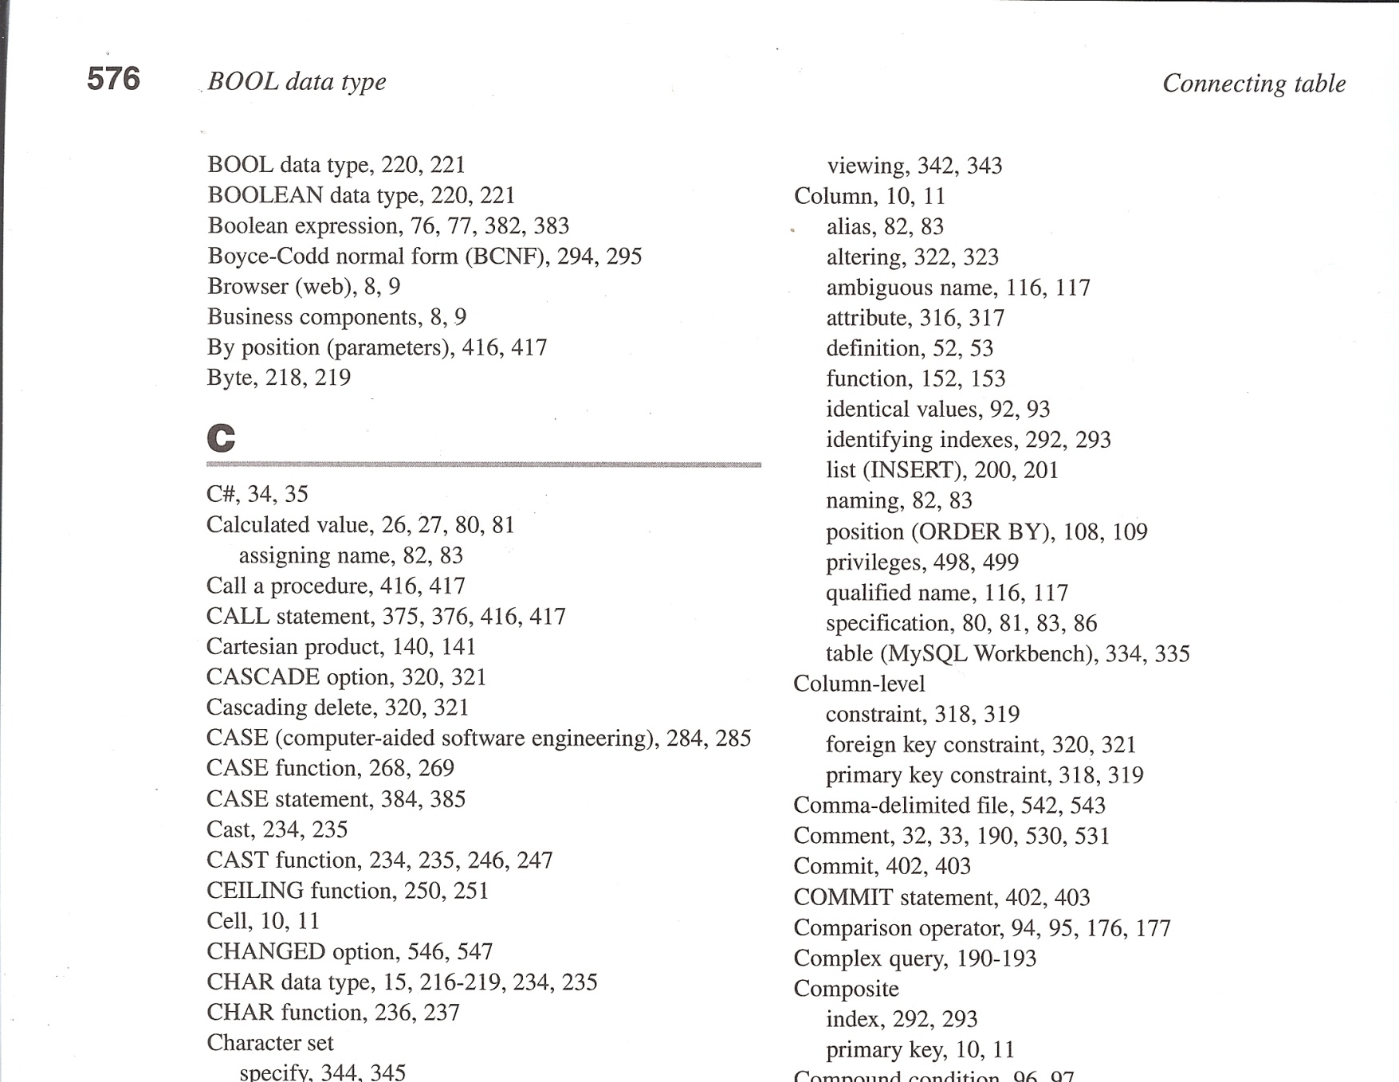

You want to know every occurrence of CEILING function
Option 1
Read entire book
Option 2
Use an index

Slide 23
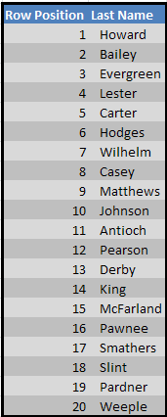
Randomly Ordered Table of Names
If we start at the top and examine one row at a time, how many rows will we need to examine before we find a randomly selected name …….
Evergreen
Smathers

Slide 24
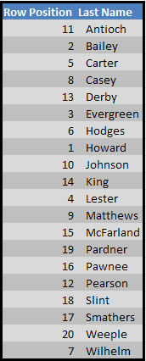
Ordered Table of Names (alphabetic)
If we do a binary search …….
finds middle with n / 2 + 1
20/2 +1 = 10+1 = 11
Evergreen
Smathers

Slide 25
INDEXES
Automatically created for primary keys, foreign keys, and unique keys of a table
Created manually for other columns that are used frequently in joins and search conditions
Use wisely – slows down inserts, updates, and deletes
Primary Key, Unique, Index, and FullText

Slide 26
Creating/Dropping Indexes
single column
CREATE INDEX invoices_invoice_date_ix
ON invoices (invoice_date)
two columns
CREATE INDEX invoices_vendor_id_invoice_number_ix
ON invoices (vendor_id, invoice_number)
Descending sequence
CREATE INDEX invoices_invoice_date_ix
ON invoices (invoice_date DESC)
Dropping an index
DROP INDEX vendors_vendor_phone_ix ON vendors

Slide 27
Character Sets/Collation
Character set
A set of symbols and encodings
Collation
A set of rules for how those characters are compared.
Commonly used character sets/collations
latin1 (latin1_swedish_ci, latin1_general_ci, latin1_general_cs, latin1_bin)
utf8 (utf8_general_ci, utf8_spanish_ci, utf8_bin)
Case Insensitive
Case Sensitive
Binary

Slide 28
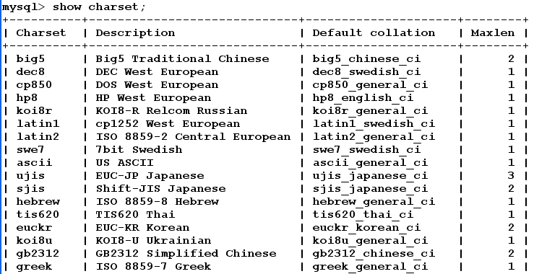
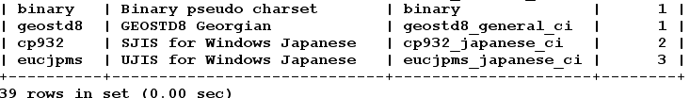
view character sets on the server

Slide 29
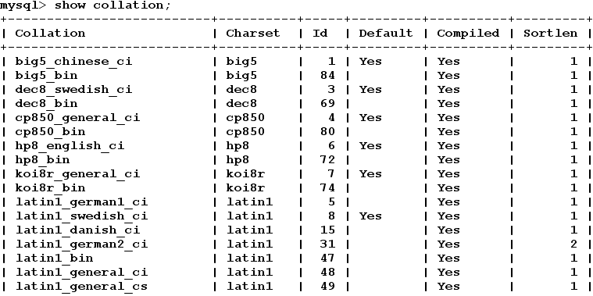
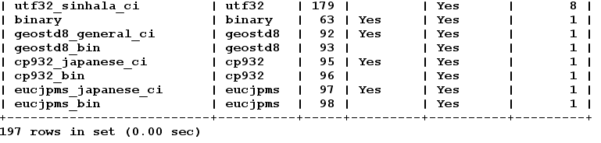
view collations on the server

Slide 30
Storage Engines
A component of the MySQL database that performs the low-level work of storing, updating, and querying data.
In MySQL 5.5 and higher, InnoDB is the default storage engine for new tables, superceding MyISAM. Different storage engines are designed with different tradeoffs between factors such as memory usage versus disk usage, read speed versus write speed, and speed versus robustness.
MyISAM
faster when dealing with fixed row size
has only table level locking
InnoDB
has row level locking
supports FKs

